Slide 1
buf_context_t
0
1
2
……
128
buf_bucket_t
buf_set_t
buckets
ctrls
lru_list
lru_scan_list
buf_ctrl_t
lru_prev,lru_next
ckpt_prev,ckpt_next
hash_next
page_header_t
memory
PAGES
CTRLS
BUCKETS

Slide 2
获取当前时间
是否上次未完成？
是
Checkpoint实现
否
是否达到间隔时间？
记录需要写盘的页数
已经全部写盘？
否
否
是否队列达到上限？
是
否
清除未完成标记
是否被外部触发？
否
sleep
否
线程已经关闭？
结束

Slide 3
Stack for each session initialized when session created
Session 1
Session 2
Session 3
Stack
level1
pos1
Stack bottom
Stack top
level2
pos2
Current pos
Push: level++, pos = curr_pos, curr_pos += size
Pop: curr_pos = level->pos, level--

Slide 4
Map Page（128KB）
128KB
Map Page
Data Pages
Ctrl 1
Ctrl 2
Ctrl 3
……
Ctrl n
Data Page1
……
Data Page n

Slide 5
Var->varno
RTE_REALTION
(STUDENT)
RTE_REALTION
(COURSE)
RTE_REALTION
(SCORE)
RTE_JOIN
Query
rtable
From Expr
RangeTblRef
JoinExpr
RangeTblRef
jointree
from list
type
larg
type
targetlist
quals
rtindex=1
rarg
rtindex=2
quals
RangeTblRef
expr
Var
Var
type
rtindex=3
args
varno=1
varno=3
expr
Var
Var
args
varno=2
varno=3

Slide 6
Query
rtable:list
2 items
targetList:List
4 items
jointree:FromExpr
1:RTE
RTE_RELATION
‘a’/16394/’r’
2:RTE
RTE_SUBQUERY/’b’
fromlist
quals:OpExpr
subquery:Query
1:RangeTblRef
rtindex=1
1:RangeTblRef
rtindex=2
opno/funcid
98/67
args
targetList:List
2 items
1:RelabelType
2:RelabelType
jointree:FromExpr
arg:VAR
arg:VAR
1:TargetEntry
(‘dwbh’)
2:TargetEntry
(‘grbh’)
rtable:list
1 items
fromlist
quals:OpExpr
varno/attno/type
1/2/1043
varno/attno/type
2/1/1043
expr:Var
1:RTE
RTE_RELATION
‘s’/16397/’r’
1:RangeTblRef
rtindex=1
opno/funcid
666/742
args
no/attno/type
1/1/1043
1:RelabelType
2:Const
arg:VAR
value:’901’
varno/attno/type
1/2/1043

Slide 7
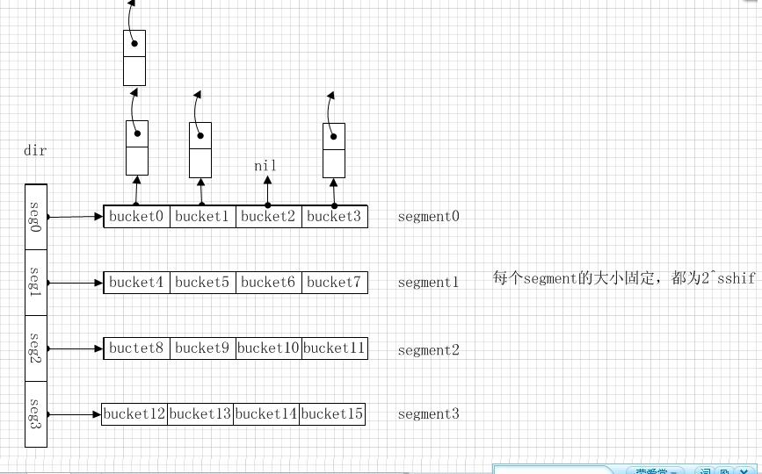
HASHCTL
/* A hash bucket is a linked list of HASHELEMENTs */
typedef HASHELEMENT *HASHBUCKET;
/* A hash segment is an array of bucket headers */
typedef HASHBUCKET *HASHSEGMENT;
Long num_partitions
Long ssize
Long dsize
Long max_dsize
HASHHDR
FreeListData
Long ffactor
Size keysize
FreeListData freeList[NUM_FREELISTS]
Slock_t mutex
Size entrysize
Long dsize
Long nentries
HASHELEMENT
HashValueFunc hash
Long nsegs
HASHELEMENT* freeList
Struct HASHELEMENT *link
HashCompareFunc match
Uint32 max_bucket
Uint32 hashvalue
HashCopyFunc alloc
Uint32 high_mask
MemoryContext hcxt
Uint32 low_mask
HASHHDR *hctl
MemoryContext hcxt
Size keySize
HTAB
Size entrySize
Long num_partitions
HASHHDR* hctl
Long ffactor
HASHSEGMENT* dir
Long max_dsize
HashValueFunc hash
Long ssize
HashCompareFunc match
Int sshift
HashCopyFunc keyCopy
Int nelem_alloc
HashAllocFunc alloc
MemoryContext hcxt
Char* tabName
Size keySize
Long ssize
Int sshift

Slide 8
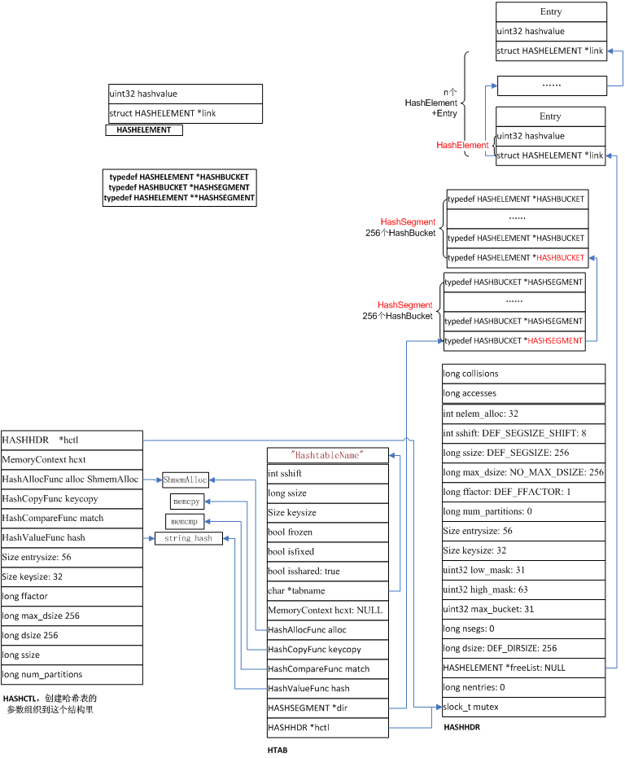

Slide 9
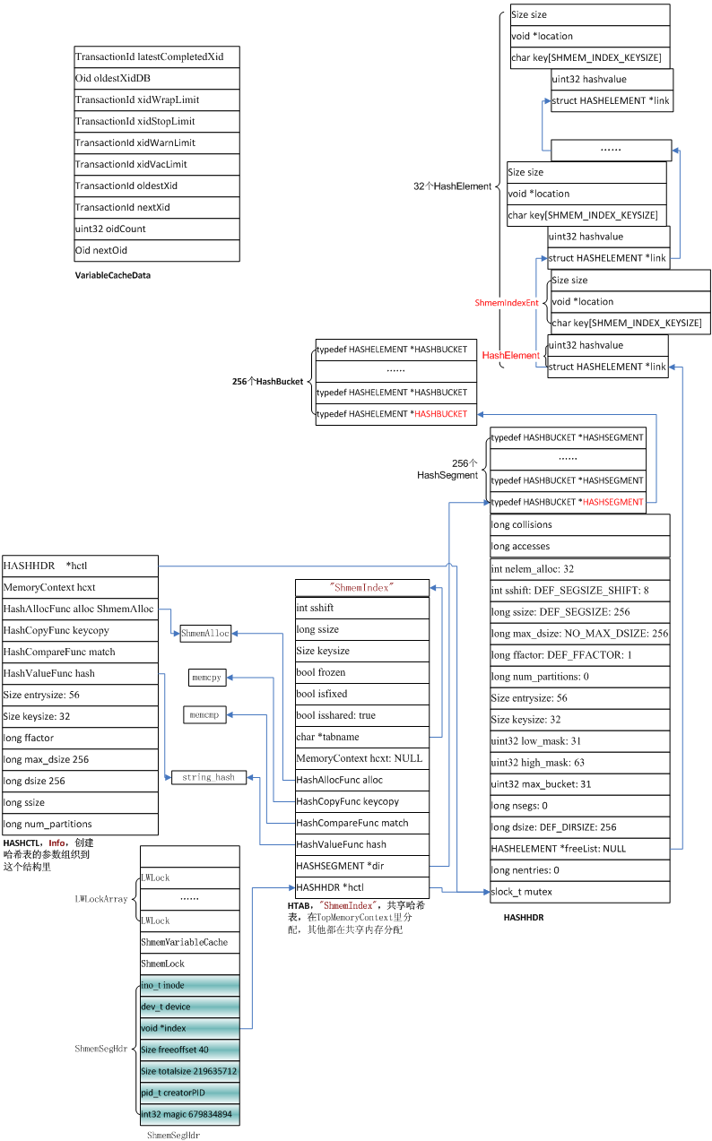

Slide 10
PostgreSQL: Shared Memory
Shared Memory
PGShmemHeader
PGReserveSemaphores
ShmemLock
ShmemVariableCache
LWLocks
ShmemIndex
XLOGShmem
……
1、PGReserveSemaphores 16128
2、slock_t *ShmemLock
3、VariableCache ShmemVariableCache
4、LWLocks
5、ShmemIndex
6、XLOGShmem 7、CLOGShmem
8、CommitsShmem
9、SubtransShmem
10、MultiXactShmem
11、BufferPool
12、InitLocks
13、PredicateLocks
14、ProcGlobal
15、SharedProcArray
16、SharedBackendStatus
17、TwoPhaseShmem
18、BackgroupWorkerShmem
19、SharedInvalidationState
20、PMSignalShmem
21、ProcSignalShmem
22、CheckpointerShmem
23、AutoVacuumShmem
24、ReplicationSlotShmem
25、WalSendShmem
26、WalRecvShmem
27、ApplyLauncherShmem
28、SnapMgr
29、BTreeShmem
30、SyncScanShmem
31、AsyncShmem

Slide 11
PostgreSQL: LWLock
typedef union LWLockPadded
{
LWLock lock;
char pad[LWLOCK_PADDED_SIZE];
} LWLockPadded;
#define ShmemIndexLock (&MainLWLockArray[1].lock)
#define OidGenLock (&MainLWLockArray[2].lock)
#define XidGenLock (&MainLWLockArray[3].lock)
#define ProcArrayLock (&MainLWLockArray[4].lock)
…….
#define LogicalRepWorkerLock (&MainLWLockArray[43].lock)
#define CLogTruncationLock (&MainLWLockArray[44].lock)
#define LOG2_NUM_LOCK_PARTITIONS 4
#define NUM_LOCK_PARTITIONS (1 << LOG2_NUM_LOCK_PARTITIONS)
#define LockHashPartition(hashcode) \
((hashcode) % NUM_LOCK_PARTITIONS)
#define LockHashPartitionLock(hashcode) \
(&MainLWLockArray[LOCK_MANAGER_LWLOCK_OFFSET + \
LockHashPartition(hashcode)].lock)
#define LockHashPartitionLockByIndex(i) \
(&MainLWLockArray[LOCK_MANAGER_LWLOCK_OFFSET + (i)].lock)
Shared Memory
PGShmemHeader
……
独立的锁
44个
Shared Buffer hashtable锁
128个（段）
Lockmgr hashtable锁
16个
Predicate hashtable锁
16个
……
/* Number of partitions of the shared buffer mapping hashtable */
#define NUM_BUFFER_PARTITIONS 128
#define BufTableHashPartition(hashcode) \
((hashcode) % NUM_BUFFER_PARTITIONS)
#define BufMappingPartitionLock(hashcode) \
(&MainLWLockArray[BUFFER_MAPPING_LWLOCK_OFFSET + \
BufTableHashPartition(hashcode)].lock)
#define BufMappingPartitionLockByIndex(i) \
(&MainLWLockArray[BUFFER_MAPPING_LWLOCK_OFFSET + (i)].lock)
#define LOG2_NUM_PREDICATELOCK_PARTITIONS 4
#define NUM_PREDICATELOCK_PARTITIONS (1 << LOG2_NUM_PREDICATELOCK_PARTITIONS)
#define PredicateLockHashPartition(hashcode) \
((hashcode) % NUM_PREDICATELOCK_PARTITIONS)
#define PredicateLockHashPartitionLock(hashcode) \
(&MainLWLockArray[PREDICATELOCK_MANAGER_LWLOCK_OFFSET + \
PredicateLockHashPartition(hashcode)].lock)
#define PredicateLockHashPartitionLockByIndex(i) \
(&MainLWLockArray[PREDICATELOCK_MANAGER_LWLOCK_OFFSET + (i)].lock)

Slide 12
PostgreSQL: ShmemIndex
Shared Memory
PGShmemHeader
……
HashHDR
Hash Segments
Hash Buckets
Hash Elements
……
Ｓｅｇｍｅｎｔ０
#define ShmemIndexLock (&MainLWLockArray[1].lock)
typedef struct HASHELEMENT
{
/* link to next entry in same bucket */
struct HASHELEMENT *link;
/* hash function result for this entry */
uint32 hashvalue;
} HASHELEMENT;
/* A hash bucket is a linked list of HASHELEMENTs */
typedef HASHELEMENT *HASHBUCKET;
/* A hash segment is an array of bucket headers */
typedef HASHBUCKET *HASHSEGMENT;
bucket0
bucket1
bucket2
bucket3
Ｓｅｇｍｅｎｔ１
ssize
bucket4
bucket5
bucket6
bucket7
dsize
Ｓｅｇｍｅｎｔ３
bucket8
bucket9
bucket10
bucket11
……
typedef struct
{
char key[SHMEM_INDEX_KEYSIZE]; /* string name */
void *location; /* location in shared mem */
Size size; /* # bytes allocated for the structure */
} ShmemIndexEnt;

Slide 13
PostgreSQL: Buffer Pool
Shared Memory
PGShmemHeader
……
Buffer Descriptors
Buffer Blocks
Buffer IO Locks
Checkpoint Buffer Ids
Buffer lookup hash table
Buffer Strategy Status
……
nextVictimBuffer = 0
firstFreeBuffer = 0
lastFreeBuffer = Nbuffers - 1
数据的读写请求
BufferLookupEnt
哈希表
key
id
key
id
…
…
Ｓｅｇｍｅｎｔ０
key
id
bucket0
bucket1
bucket2
bucket3
缓冲区描述符
Ｓｅｇｍｅｎｔ１
ssize
缓冲区
bucket4
bucket5
bucket6
bucket7
dsize
Ｓｅｇｍｅｎｔ３
bucket8
bucket9
bucket10
bucket11
……
/* entry for buffer lookup hashtable */
typedef struct
{
BufferTag key; /* Tag of a disk page */
int id; /* Associated buffer ID */
} BufferLookupEnt;
磁盘

